Slide 1
CENG 538
Advanced Graphics and UIs
Parameterization (for texture mapping)

Slide 2
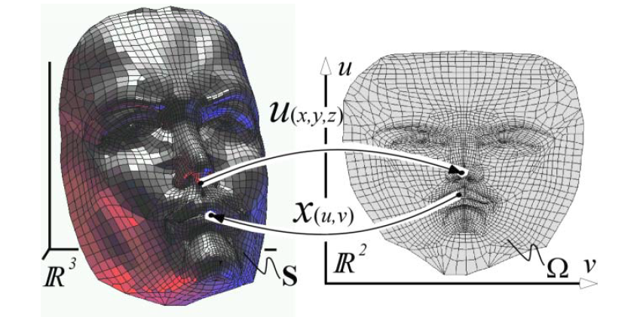
Mesh Parameterization
<number> / 53
Given a surface mesh in 3D, and a domain (mostly in 2D, e.g., for texture mapping), find a bijective mapping between them.

Slide 3
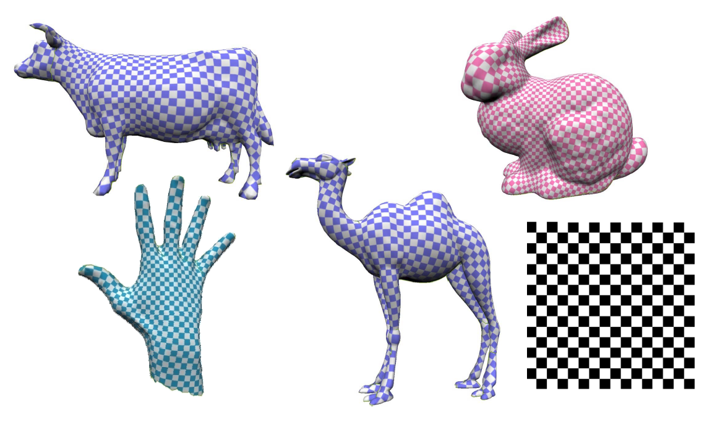
Mesh Parameterization
<number> / 53
Motivation: parameterization enables transferring of nice features from one domain to the other, e.g., main app: Texture Mapping: transfer of textures from 2D to the surface in 3D.

Slide 4
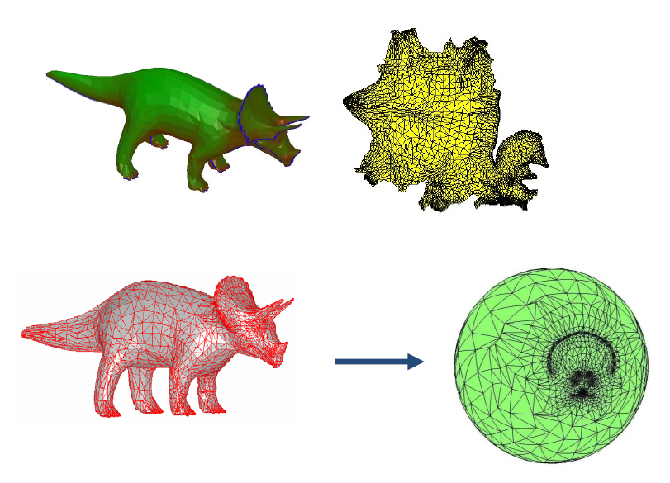
Mesh Parameterization
<number> / 53
Motivation: parameterization enables transferring of nice features from one domain to the other, e.g., main app: Texture Mapping: transfer of textures from 2D to the surface in 3D.
Top: more useful parameterization, e.g.. texture mapping.
Bottom: spherical parameterization.

Slide 5
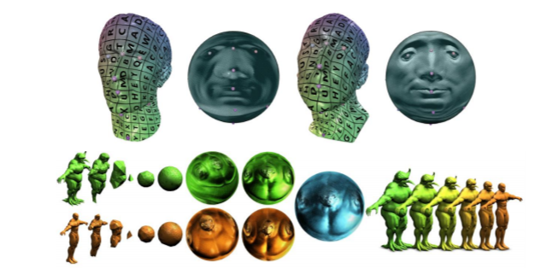
Mesh Parameterization
<number> / 53
Motivation: parameterization enables transferring of nice features from one domain to the other, e.g., main app: Texture Mapping: transfer of textures from 2D to the surface in 3D.
Top: more useful parameterization, e.g.. texture mapping.
Bottom: spherical parameterization.
  Apps for spherical parameterization.
Correspondence:
Morphing:

Slide 6
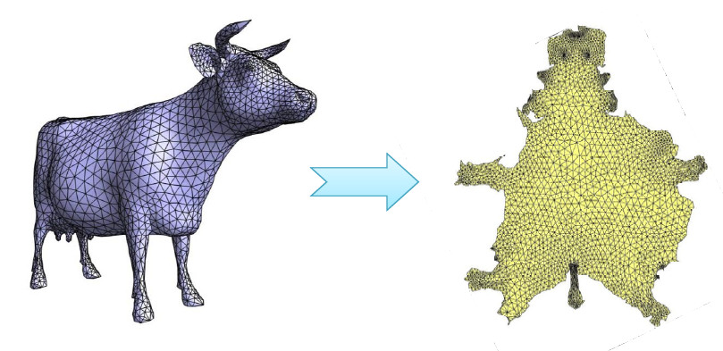
Mesh Parameterization
<number> / 53
Motivation: parameterization enables transferring of nice features from one domain to the other, e.g., main app: Texture Mapping: transfer of textures from 2D to the surface in 3D.

Slide 7
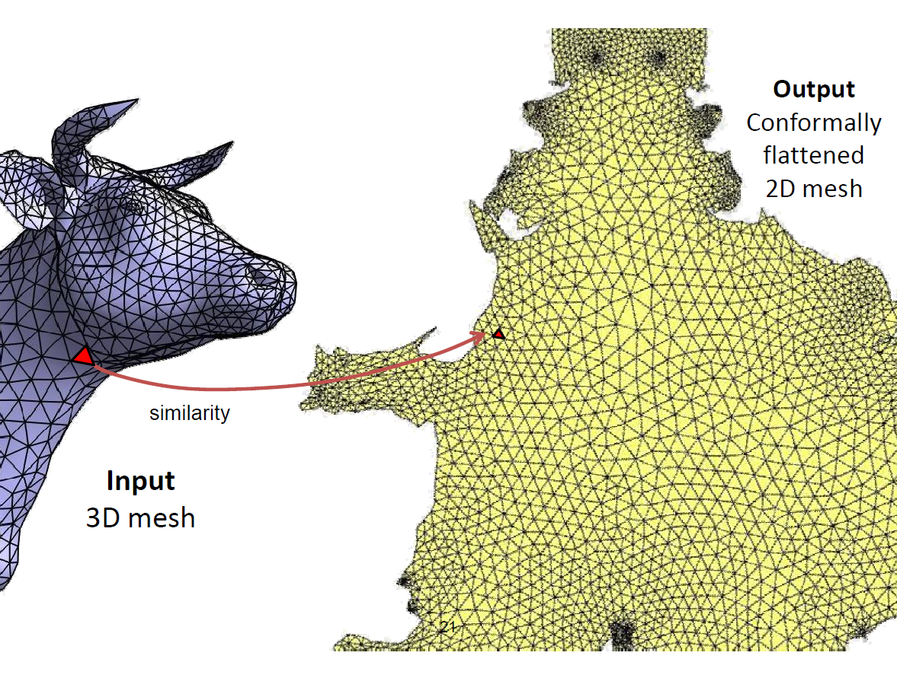
Mesh Parameterization
<number> / 53
Motivation: parameterization enables transferring of nice features from one domain to the other, e.g., main app: Texture Mapping: transfer of textures from 2D to the surface in 3D.

Slide 8
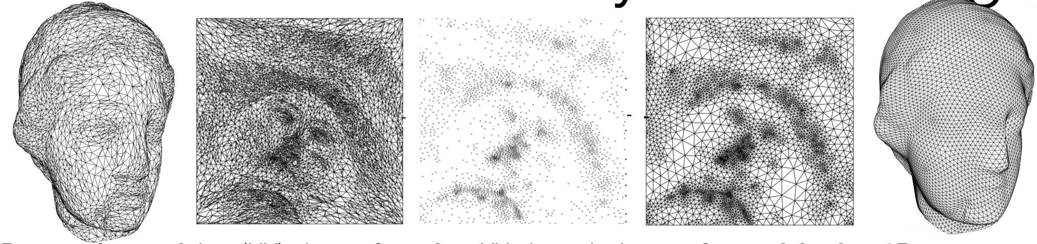
Remeshing
<number> / 53
Unfold/flatten/unwrap/parameterize a surface mesh in 3D to 2D plane.
Pull back whatever structure you need: texture, vector field, triangltion, etc. Here we pull back triangulation for remeshing application.
Parametrize mesh into (UV) plane, triangulate UV plane nicely (e.g., Delaunay, self-design*), transfer mesh back to 3D.
http://asdf.geometry.caltech.edu/pubs/AMD02.pdf
* Minimize post-transfer distortion: detect creases in original mesh, constrain these to be edges in
triangulation. Increase sampling in important, e.g., high-curvature, regions. And so on.

Slide 9
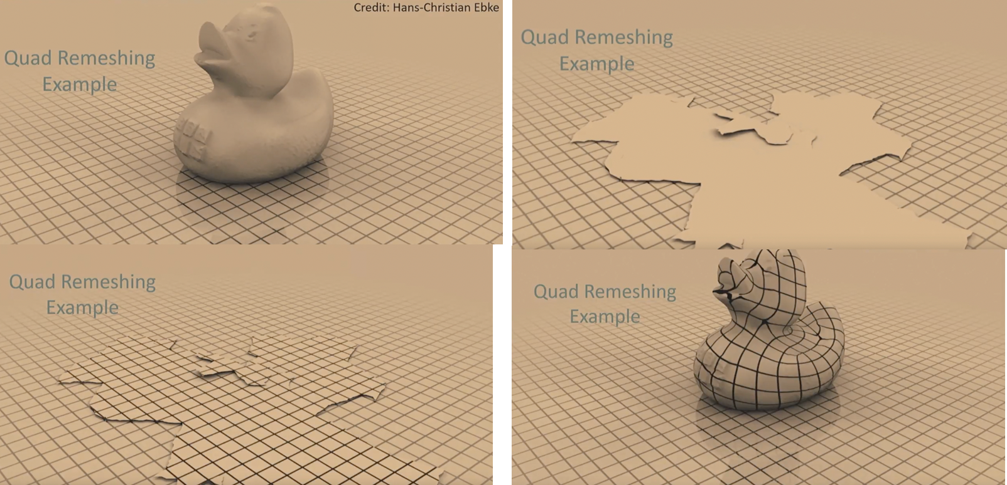
Remeshing
<number> / 53
Unfold/flatten/unwrap/parameterize a surface mesh in 3D to 2D plane.
Pull back whatever structure you need: texture, vector field, grid pattern, etc. Here we pull back grid pattern for remeshing application.

Slide 10
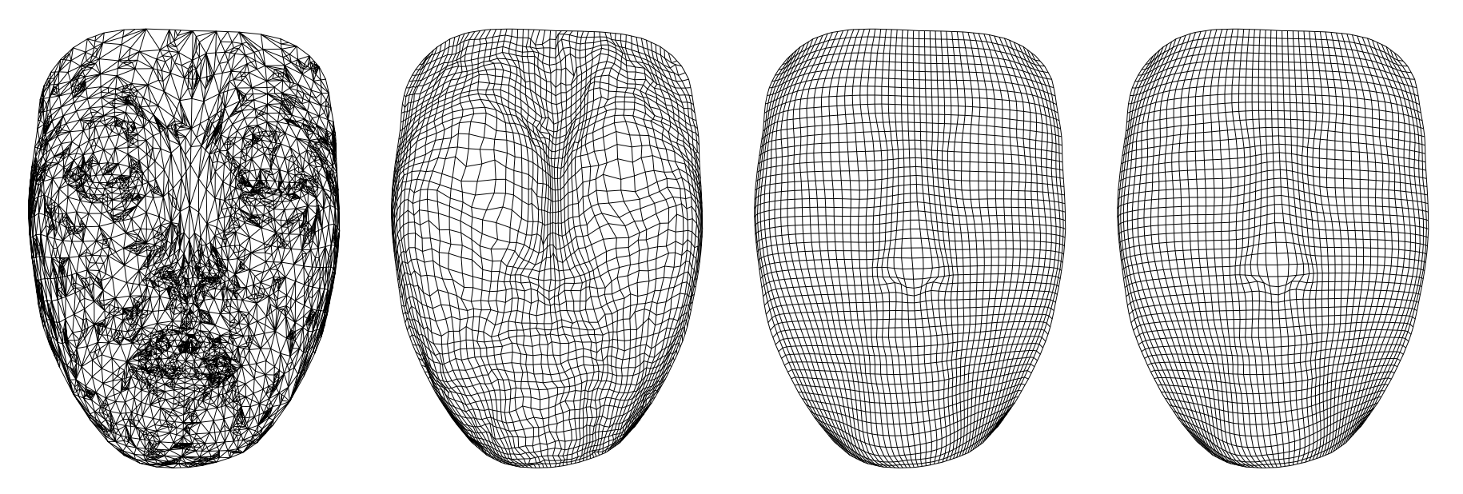
Remeshing
<number> / 53
Unfold/flatten/unwrap/parameterize a surface mesh in 3D to 2D plane.
Pull back whatever structure you need: texture, vector field, grid pattern, etc. Here we pull back grid pattern for remeshing application.
Input Outputs w/ 3 different methods
Find the 3D coordinate of each grid vertex g: Suppose 2D triangle t contains g. Find barycentric coords of g in t. Apply these barycentric coords to the 3D vertex coordinates of 3D version of t.

Slide 11
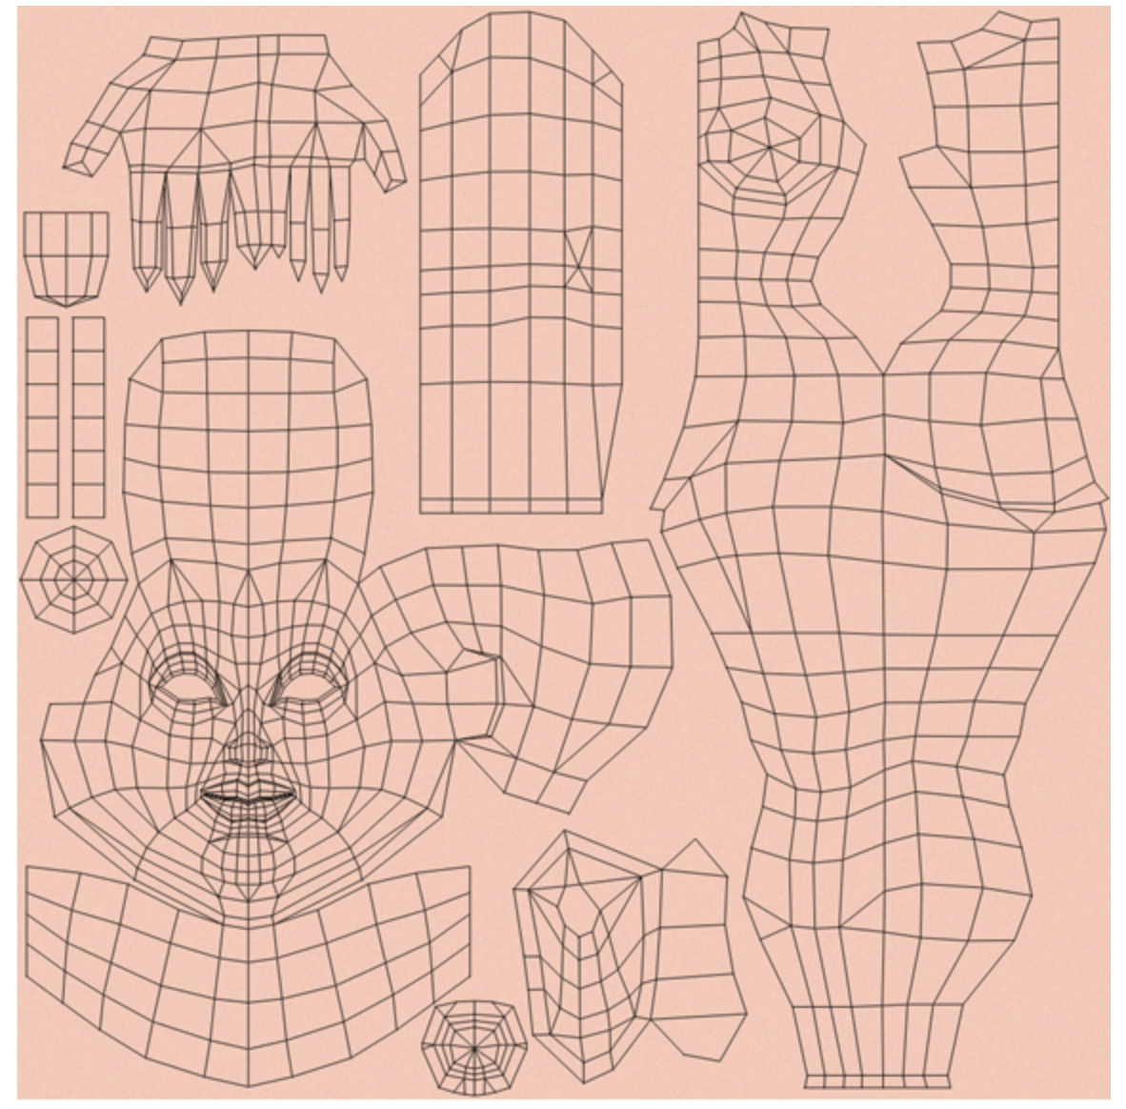
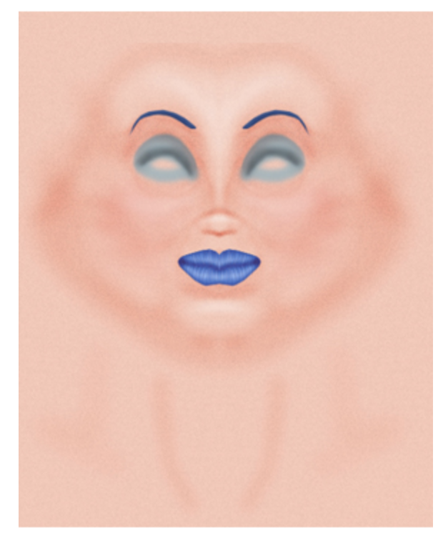
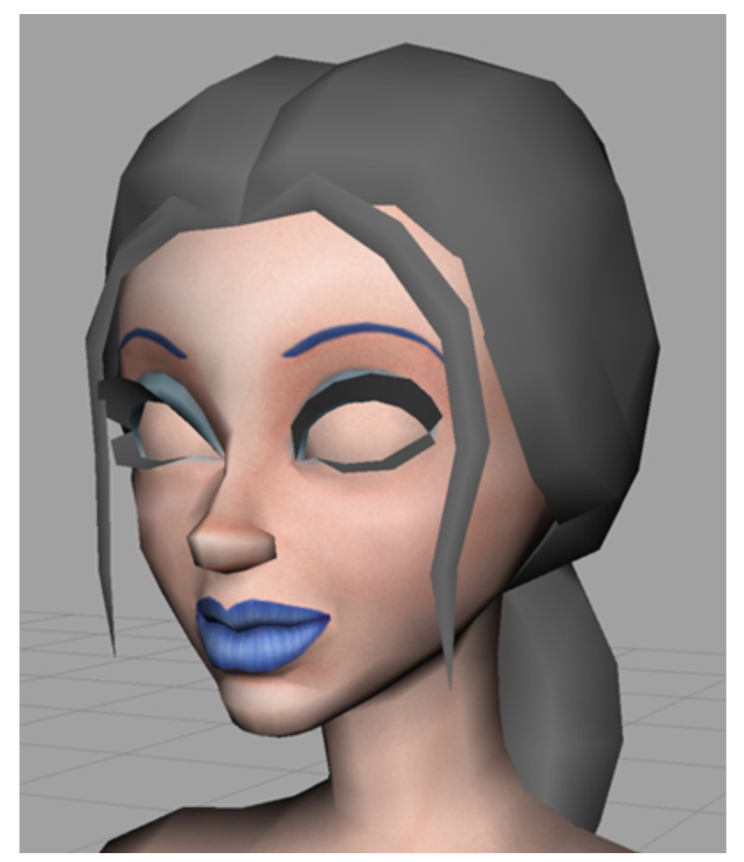
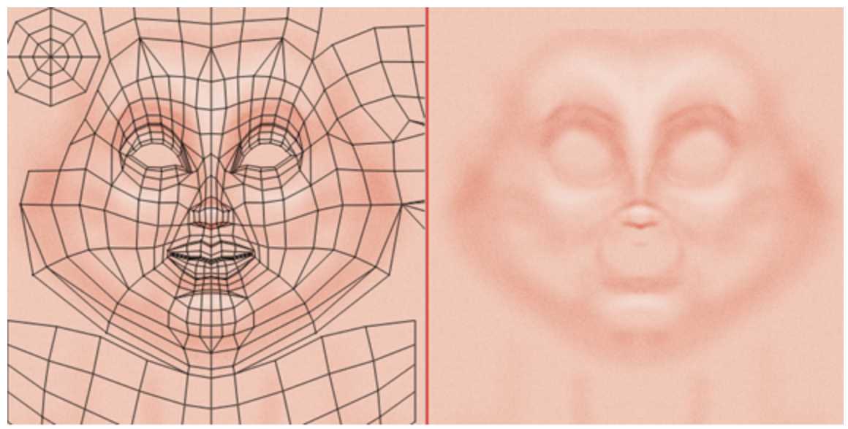
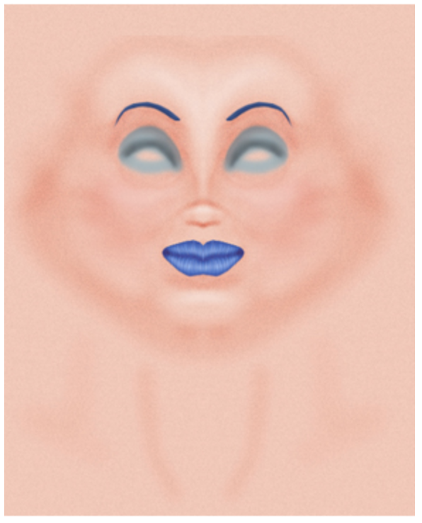
Texture Mapping
<number> / 53
Unfold/flatten/unwrap/parameterize a surface mesh in 3D to 2D plane.
Pull back whatever structure you need: texture, vector field, grid pattern, etc. Here we pull back color for texture mapping application.
Base skin texture.
Artist paints in some
highlights & make-up.
See details of texture creation: https://software.intel.com/en-us/articles/creating-textures-for-characters-in-autodesk-maya

Slide 12
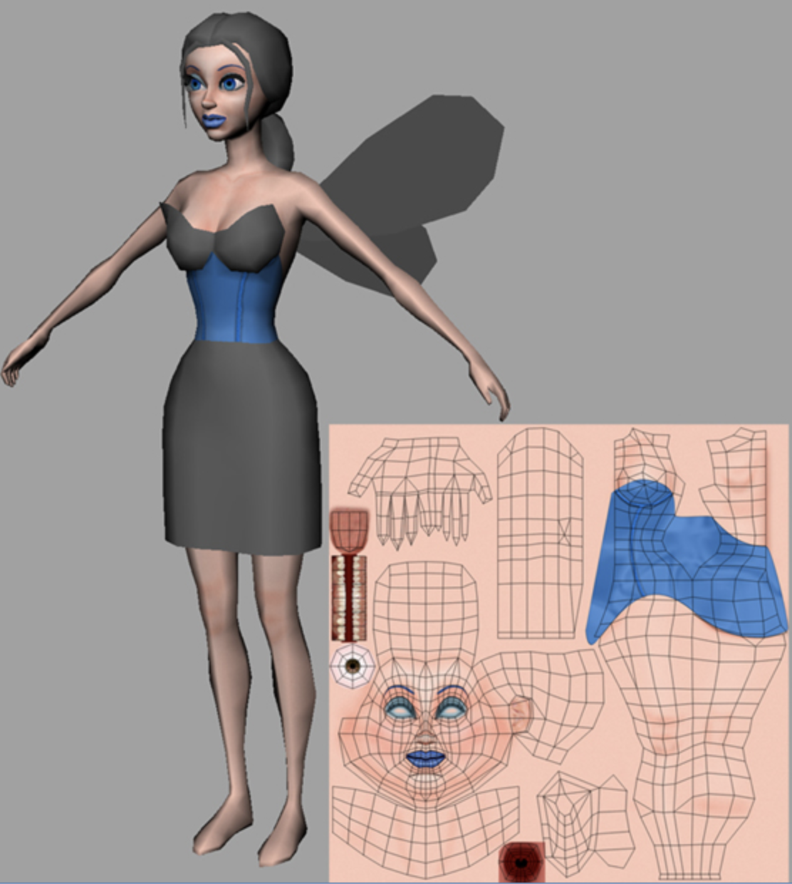
Texture Mapping
<number> / 53
Unfold/flatten/unwrap/parameterize a surface mesh in 3D to 2D plane.
Pull back whatever structure you need: texture, vector field, grid pattern, etc. Here we pull back color for texture mapping application.

Slide 13
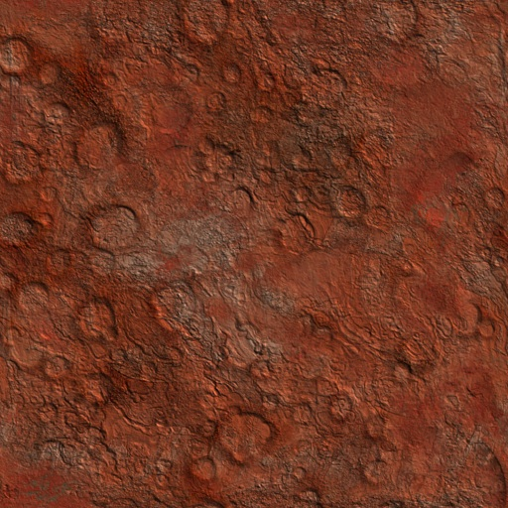
Texture Mapping Roadmap
<number> / 53
Step 1: Associate an (u, v) coordinate system with the texture image where (u, v) ∈ [0,1]x[0,1]
v
u

Slide 14
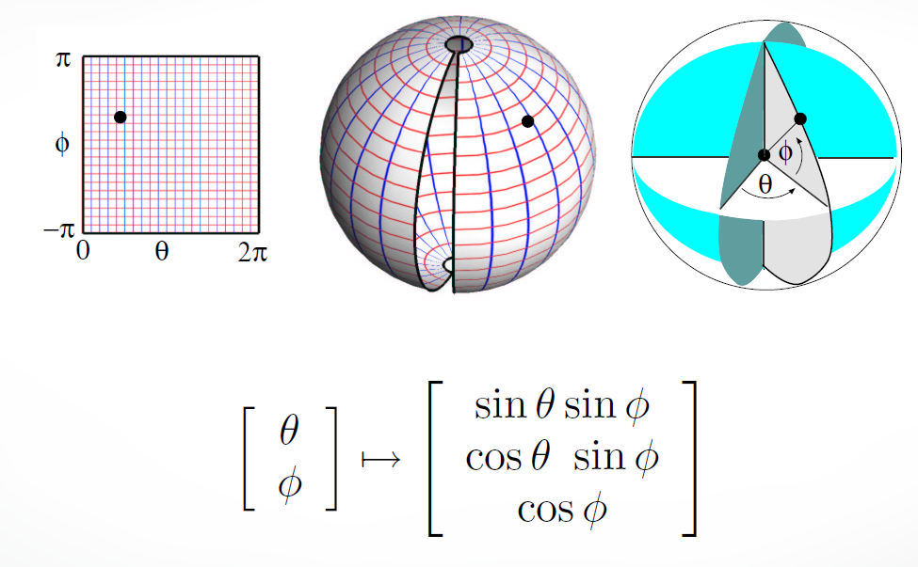
Texture Mapping Roadmap
<number> / 53
Step 2: Parameterize the surface to be texture mapped using two coordinates. For instance, a sphere can be parametrized by 2 params:

Slide 15
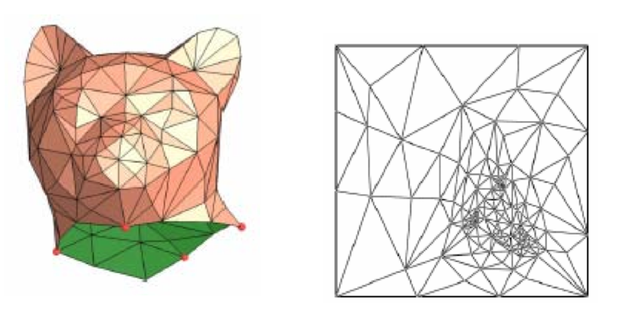
Texture Mapping Roadmap
<number> / 53
Step 2: We will learn this parameterization for generic shapes, where there is no analytical representation like the sphere case.

Slide 16
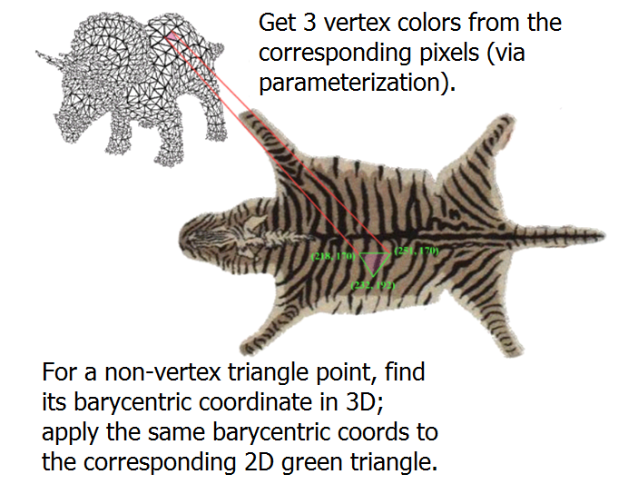
Texture Mapping Roadmap
<number> / 53
Step 2: We will learn this parameterization for generic shapes, where there is no analytical representation like the sphere case.

Slide 17
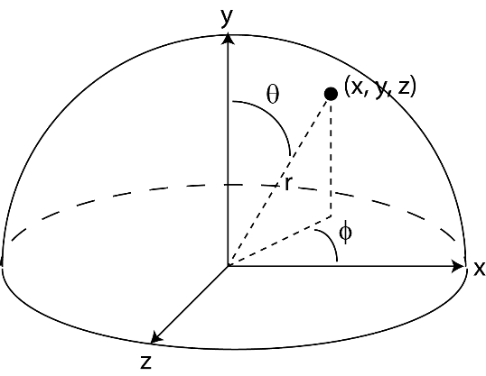
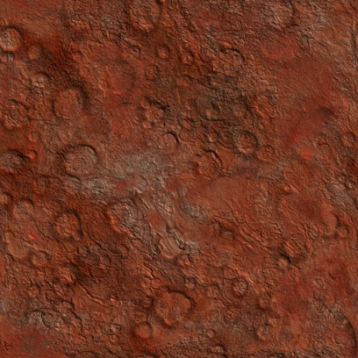
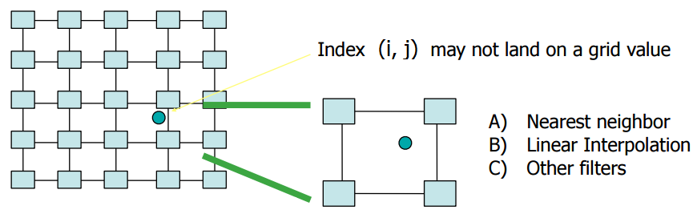
Texture Mapping Roadmap
<number> / 53
Step 3: Compute a (u, v) value for every surface point. For instance, a sphere:
Step 4: Find the texture image coordinate (i, j) at the given (u, v) coordinate:
u = ϕ / (2π)
v = (π – Θ) / π = 1 – Θ/ π
i = u.n_{x}
Note that i, j can be fractional!
j = v.n_{y}
n_{x} = texture image width
n_{y} = texture image height

Slide 18
Texture Mapping Roadmap
<number> / 53
Step 5: Choose the texel color using a suitable interpolation strategy.
Nearest Neighbor: fetch texel at nearest coordinate
Color(x, y, z) = fetch(round(i, j))
Bilinear Interpolation: Average four closest neighbors:
Color(x, y, z) = fetch(round(i, j)).(1 – a).(1 – b) +
fetch(round(i+1, j)).(a).(1 – b) +
fetch(round(i, j+1)).(1 – a).(b) +
fetch(round(i+1, j+1)).(a).(b)
(i,j)
b
a

Slide 19
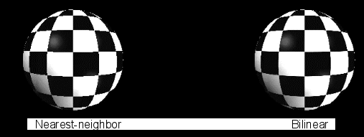
Texture Mapping Roadmap
<number> / 53
Step 5: Choose the texel color using a suitable interpolation strategy.
Nearest Neighbor: fetch texel at nearest coordinate
Color(x, y, z) = fetch(round(i, j))
Bilinear Interpolation: Average four closest neighbors:

Slide 20
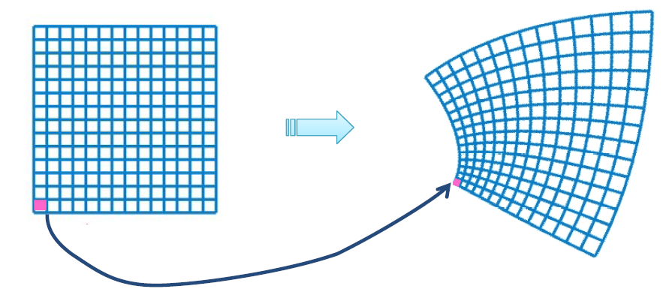
Parameterization Types
<number> / 53
Conformal (angle preserving): if the angle of every pair of intersecting curves on surface is the same as that of the corresponding preimages.
Equiareal (area preserving): if every part of one domain is mapped onto a part in the other domain w/ the same area.
Isometric (length preserving): if the length of any arc on surface is the same as that of its preimage. Isometric = conformal + equiareal.

Slide 21
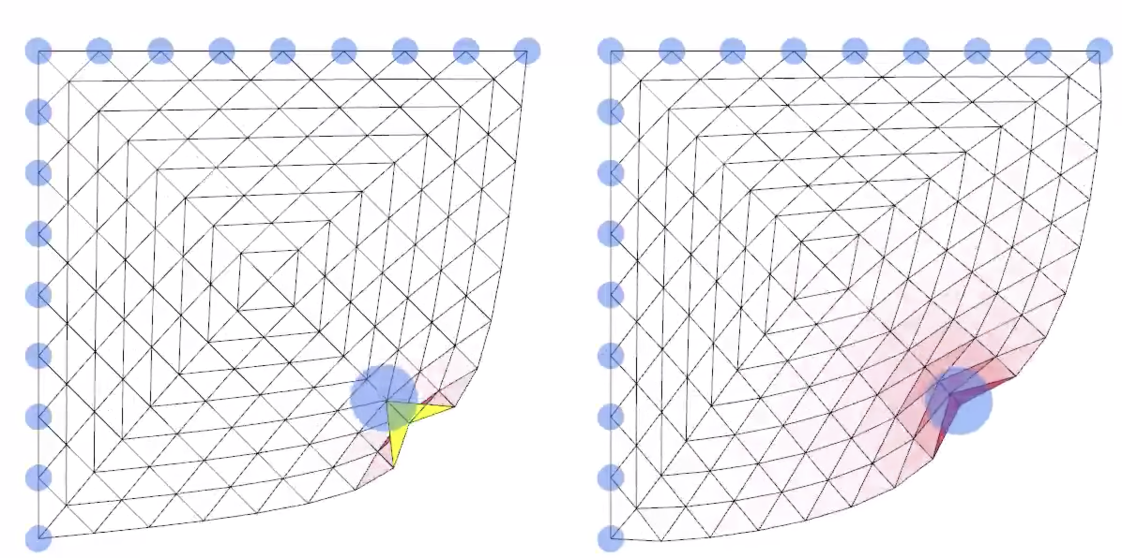
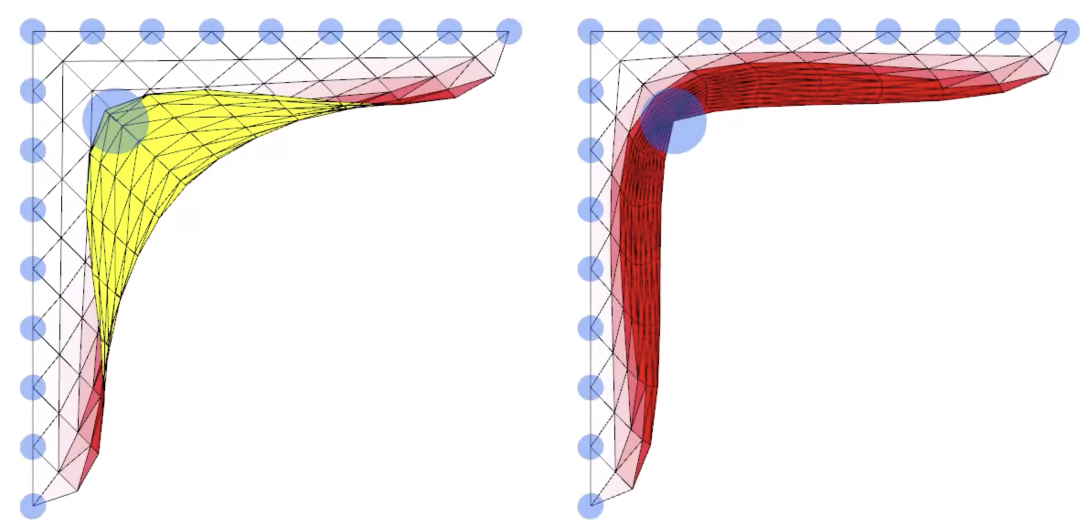
Parameterization Bijectivity
<number> / 53
Bijective parameterization: each mapped 2D point corresponds to exactly one 3D point.
Desired property.
  Non-bijective one will, for instance, give the same texture color (at 2D coordinate c) to two distant 3D points that correspond to c.
Local overlap. No local overlap. Local overlap. No local overlap.
(normal of the highlighted
flipped triangle is inverted
w.r.t. the other triangle normals).

Slide 22
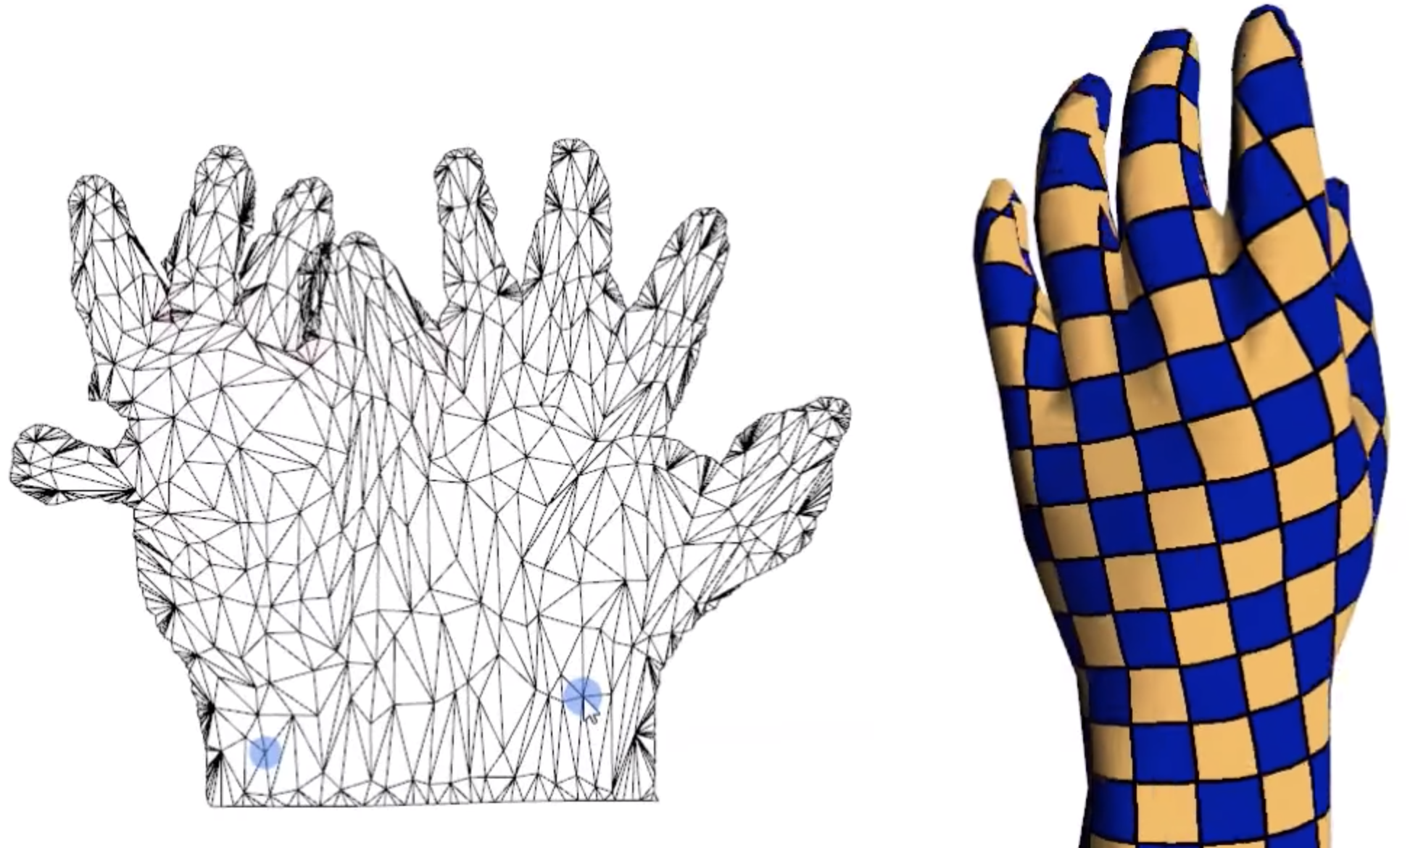
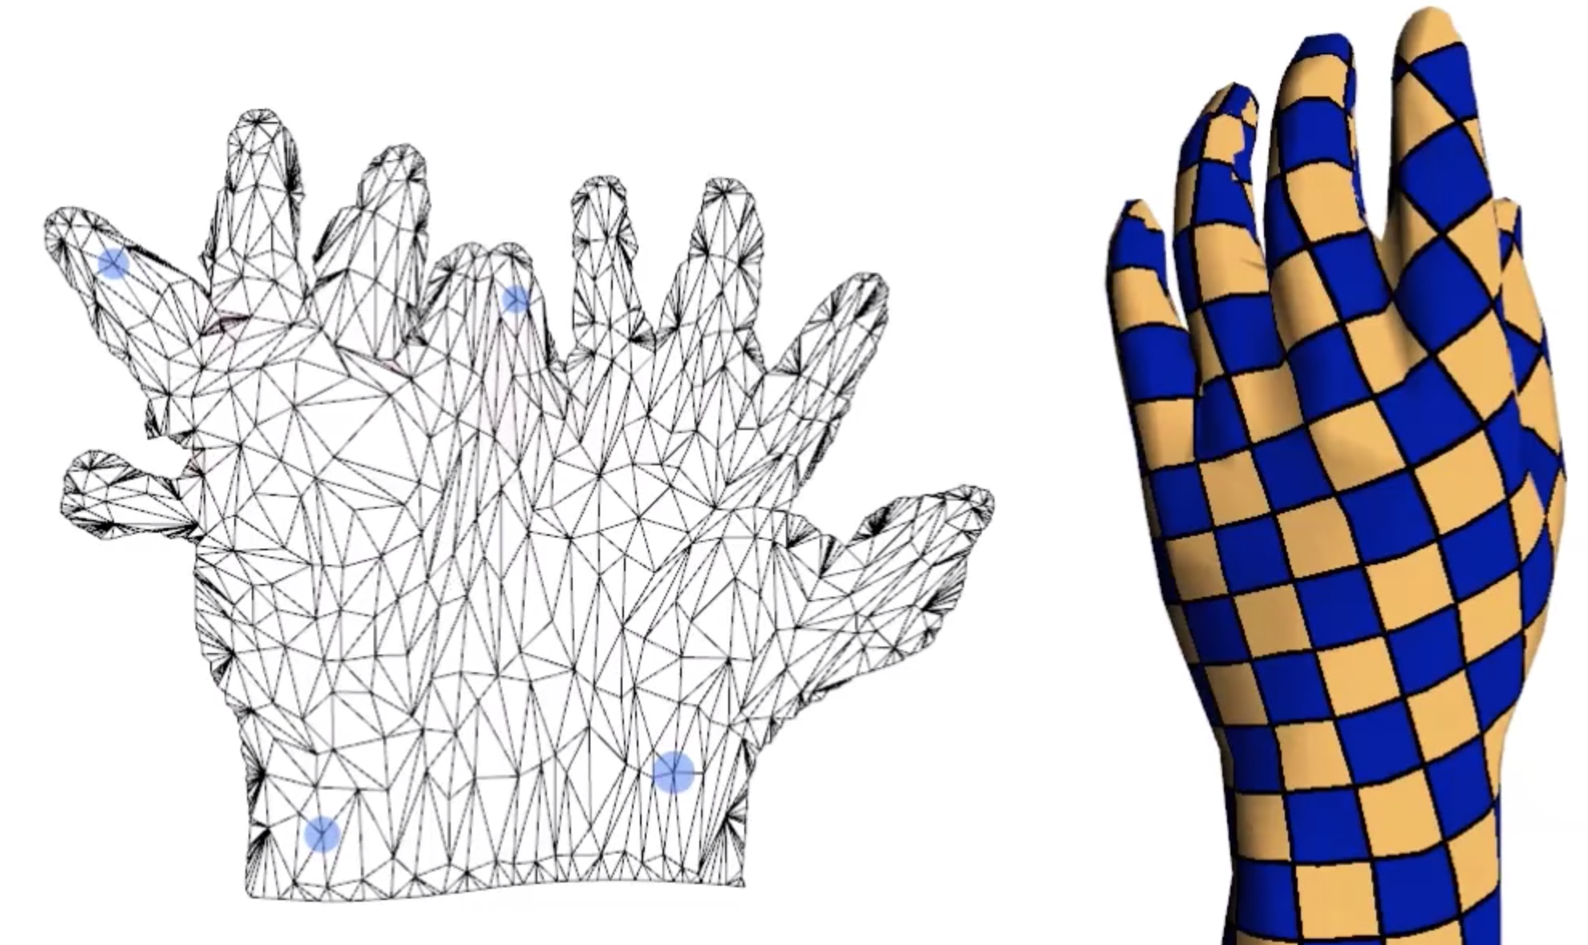
Parameterization Bijectivity
<number> / 53
Bijective parameterization: each mapped 2D point corresponds to exactly one 3D point.
Desired property.
  Non-bijective one will, for instance, give the same texture color (at 2D coordinate c) to two distant 3D points that correspond to c.
Global overlap. Global overlap fixed.

Slide 23
Linear Parameterization Methods
<number> / 53
In the next parameterization approaches, we will see 2 stages:
  Boundary vertices of the mesh are mapped to the boundary of a convex region in 2D, e.g., disk.
  Then the positions of the remaining vertices are obtained by solving a linear system: Wx = b ➔ x = W⁻¹b.
We will not cover non-linear methods that are typically slower but more accurate in terms of minimizing parameterization distortion.
  Read: Mesh Parameterization Methods and Their Applications.

Slide 24
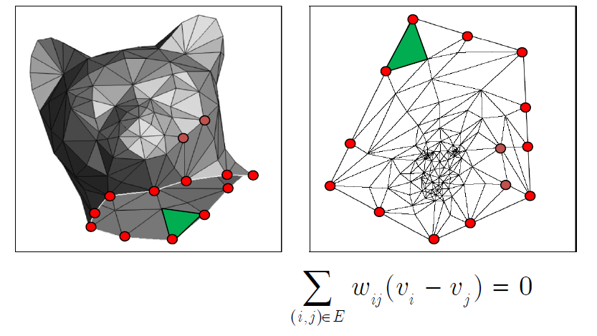

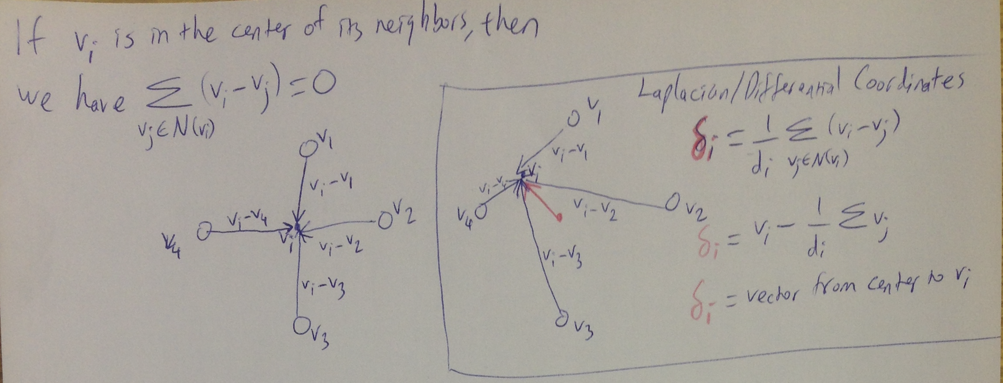
Disk Parameterization
<number> / 53
Method 1: map with uniform weights.
Sets the new coordinate of non-boundary vertices as the simple center of the vertices of its 1-ring neighborhood.
Bijective: each mapped 2D point corresponds to exactly one 3D point.

Slide 25
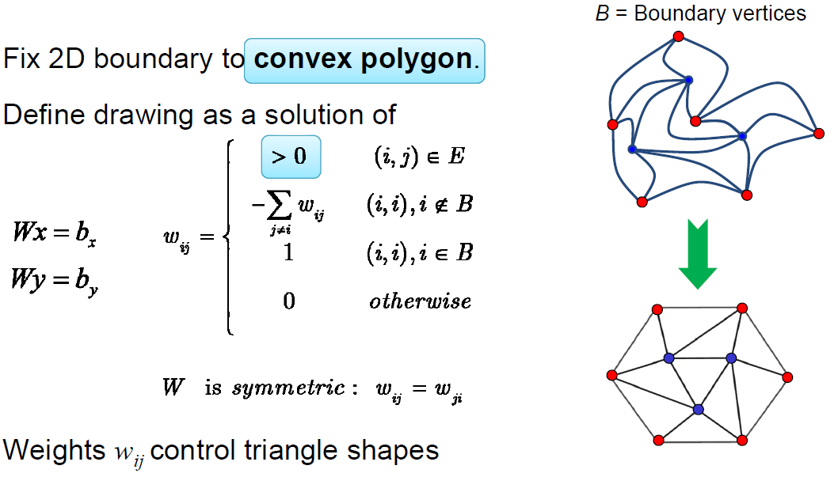

Disk Parameterization
<number> / 53
Method 1: map with uniform weights.
Sets the new coordinate of non-boundary vertices as the simple center of the vertices of its 1-ring neighborhood.

Slide 26
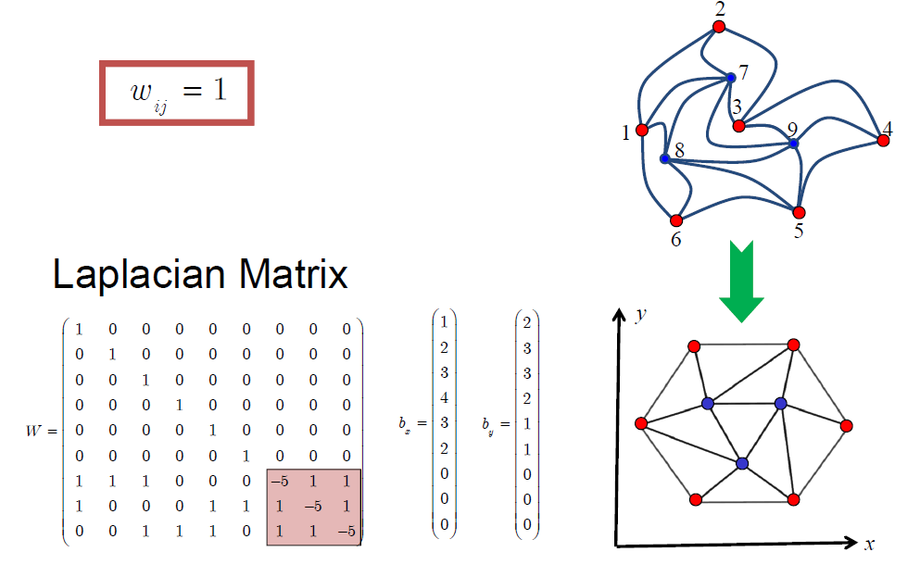
Disk Parameterization
<number> / 53
Method 1: map with uniform weights.
Sets the new coordinate of non-boundary vertices as the simple center of the vertices of its 1-ring neighborhood.

Slide 27
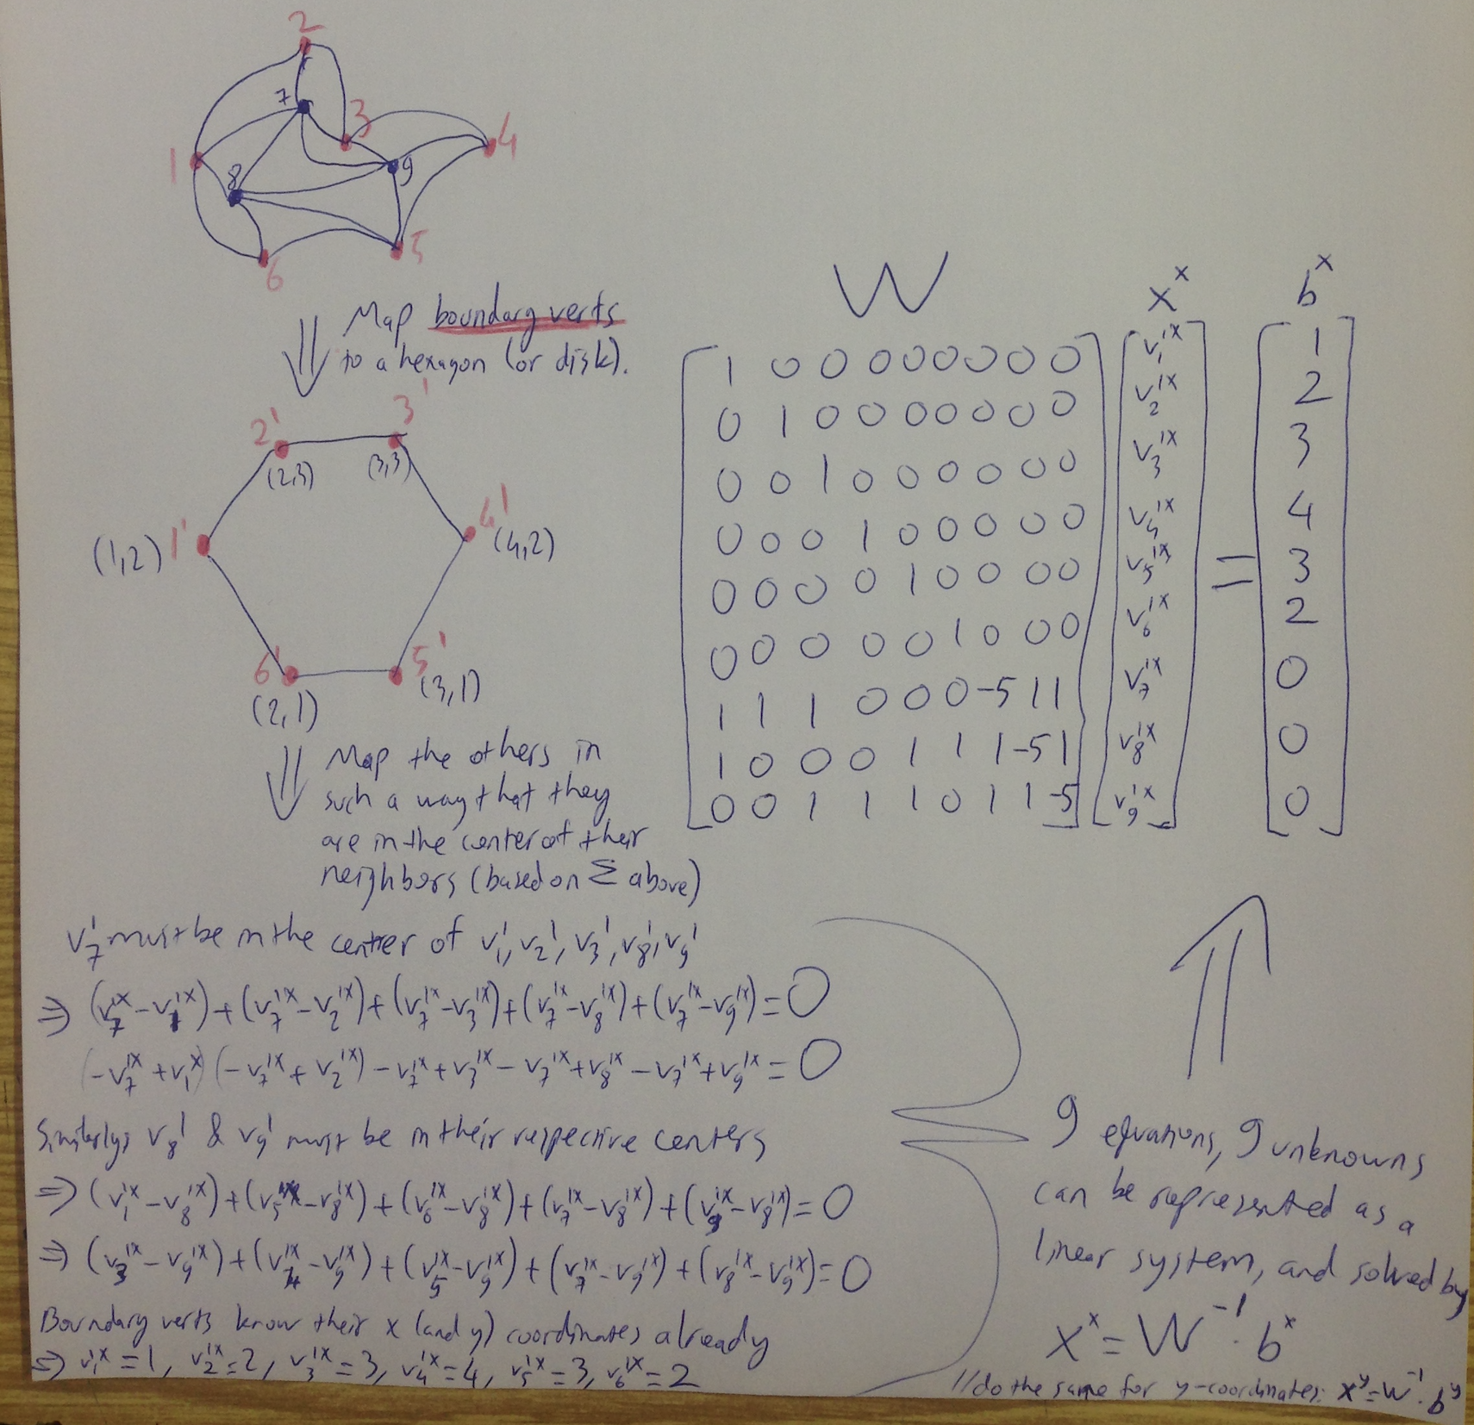
Disk Parameterization
<number> / 53
Method 1: map with uniform weights.
Sets the new coordinate of non-boundary vertices as the simple center of the vertices of its 1-ring neighborhood.

Slide 28
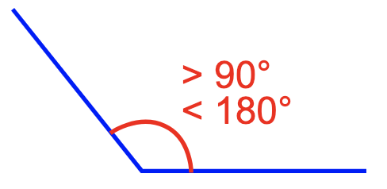
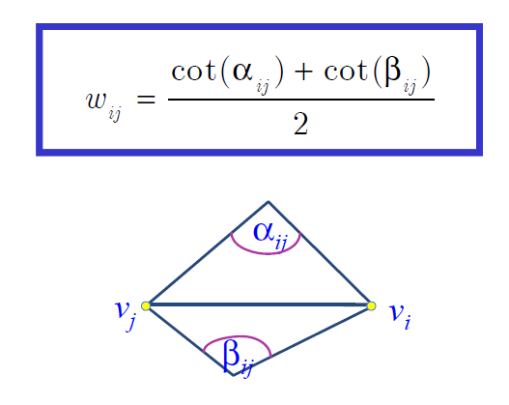
Disk Parameterization
<number> / 53
Method 2: map with harmonic (or cotangent) weights.
Sets the new coordinate of non-boundary vertices as the weighted average of vertices of its 1-ring neighborhood.
Angel-preserving parameterization achieved ☺.
If mesh contains obtuse angles, the weights can be negative, and, as a result, parameterization can be non-bijective: 2D triangles overlap ☹.
harmonic weights:

Slide 29
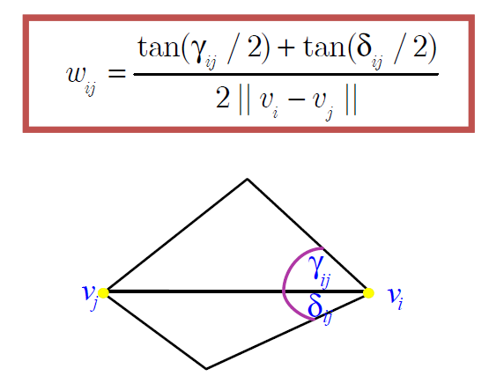
Disk Parameterization
<number> / 53
Method 3: map with mean-value weights.
Sets the new coordinate of non-boundary vertices as the weighted average of vertices of its 1-ring neighborhood.
Angel-preserving parameterization achieved ☺.
Bijective ‘cos weights are certainly positive ☺.
Weights vary non-smoothly as vertex move inside its 1-ring polygon ☹.
In some cases introduce larger angular distortion than harmonic w’s ☹.
mean-value weights:

Slide 30
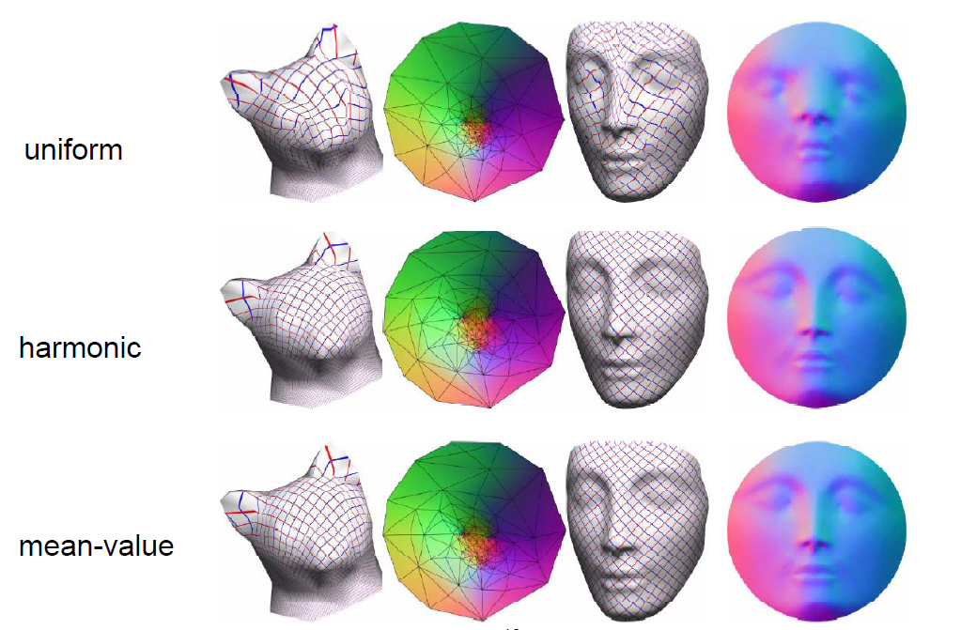
Disk Parameterization
<number> / 53
Methods compared.

Slide 31
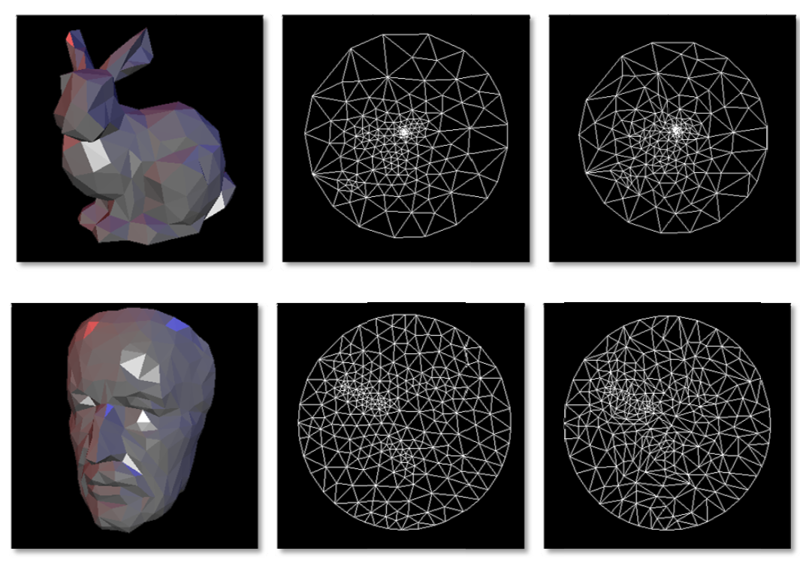
Disk Parameterization
<number> / 53
Methods compared. Middle: uniform weights, right: harmonic weights.

Slide 32
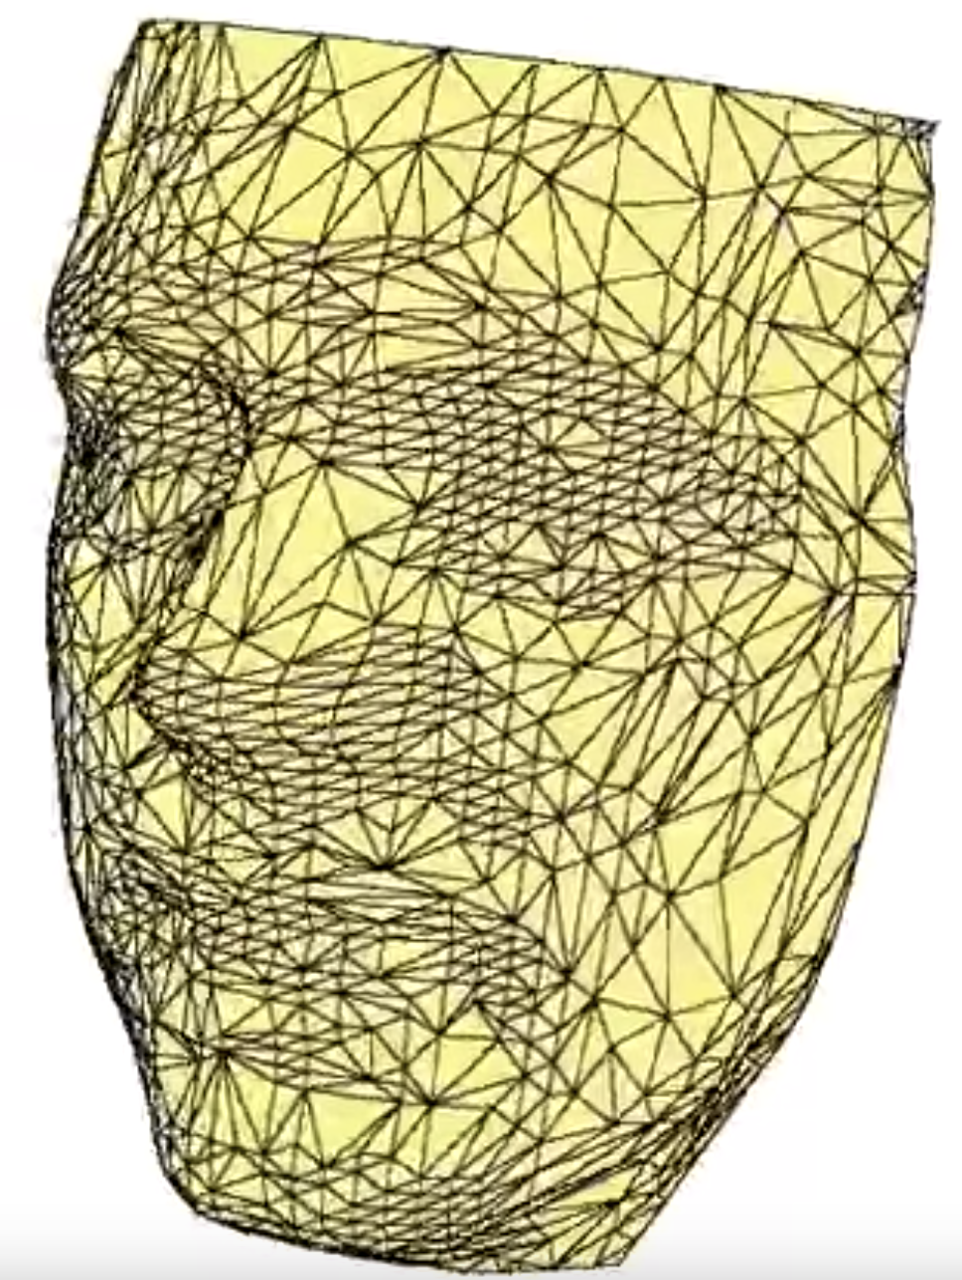
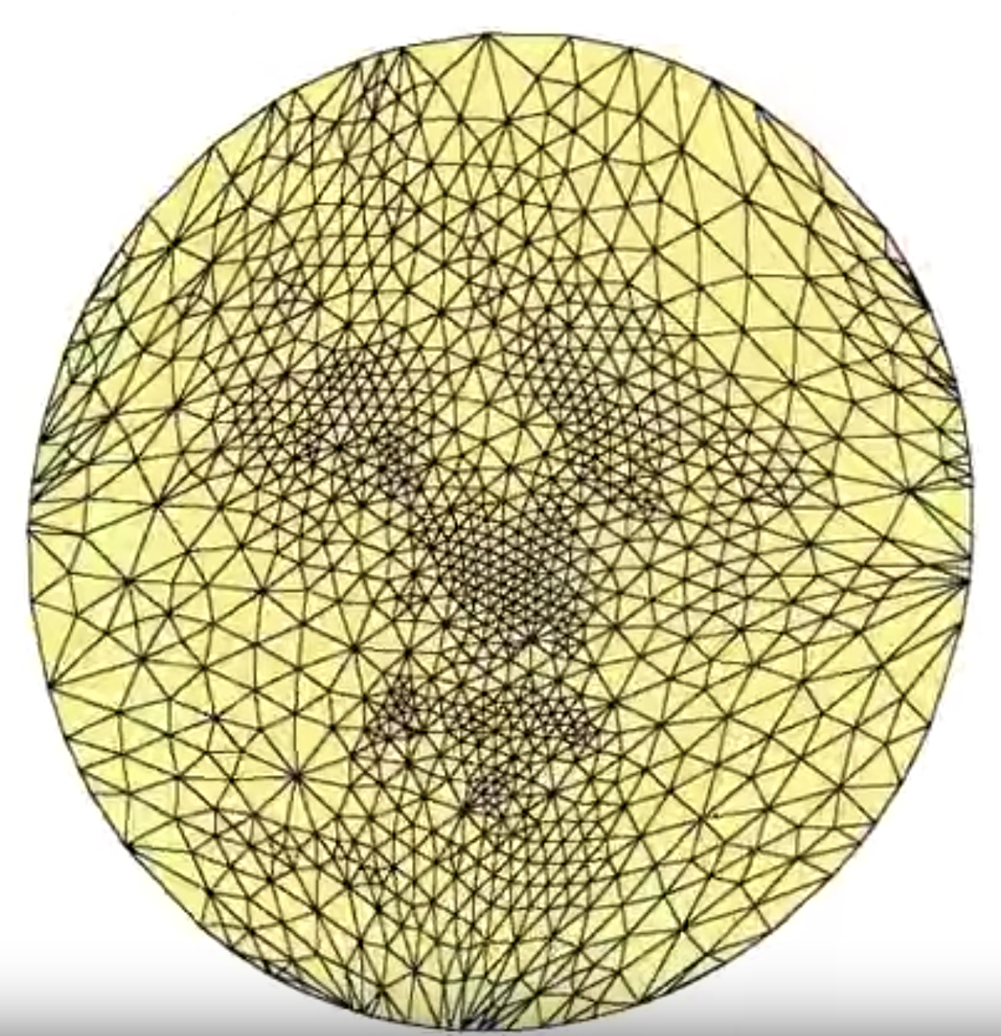
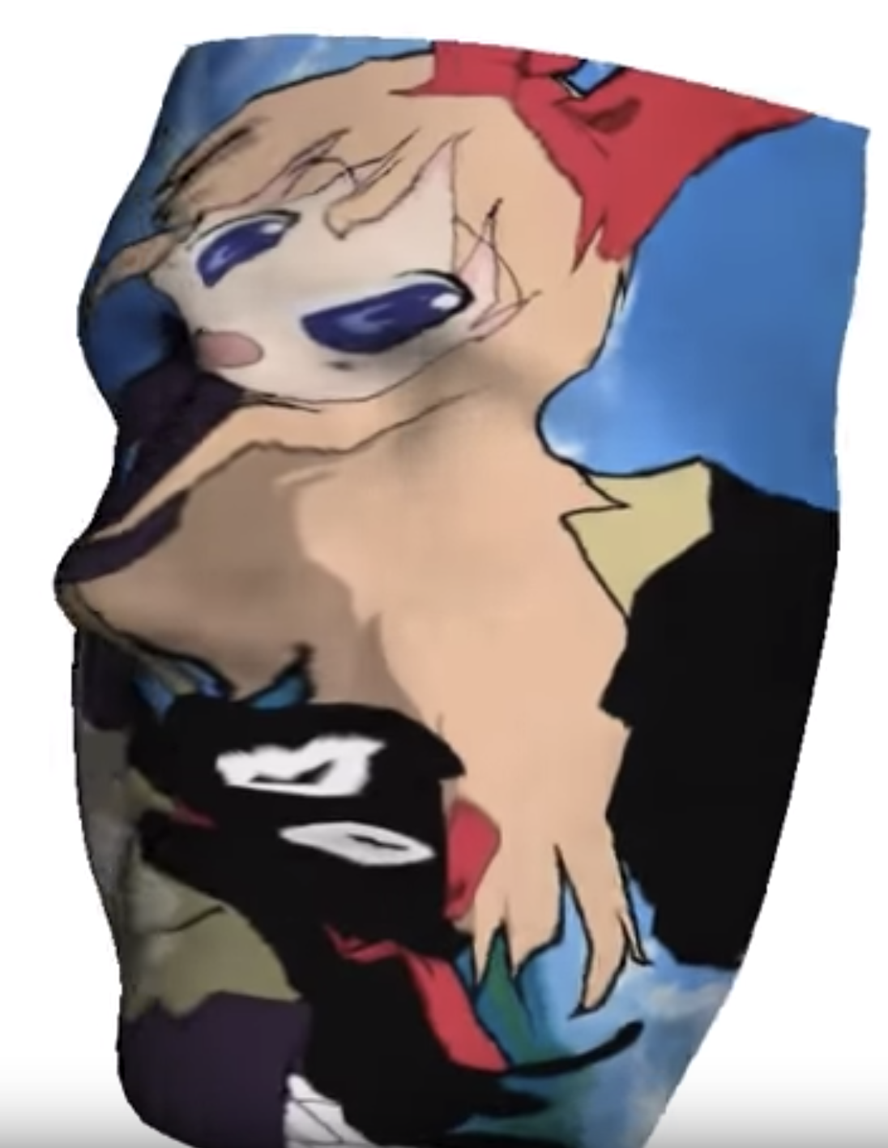

Disk Parameterization
<number> / 53
Method 1 is used for texture mapping application.
(1) (2)
(4) (3)

Slide 33
Disk Parameterization
<number> / 53
Method 2 (harmonic weights) can be improved by making it bijective.
To do that, simply make the 3D mesh Delaunay (simple greedy algorithm based on flipping non-Delaunay edges).
  It has been proven that if the mesh satisfies the Delaunay criterion, even if it contains obtuse triangles, the parameterization obtained using the cotangent weights will always be bijective.
In general, it is a good idea to improve the mesh quality, e.g., by bisecting obtuse angles or flipping edges, prior to applying any parameterization method.

Slide 34
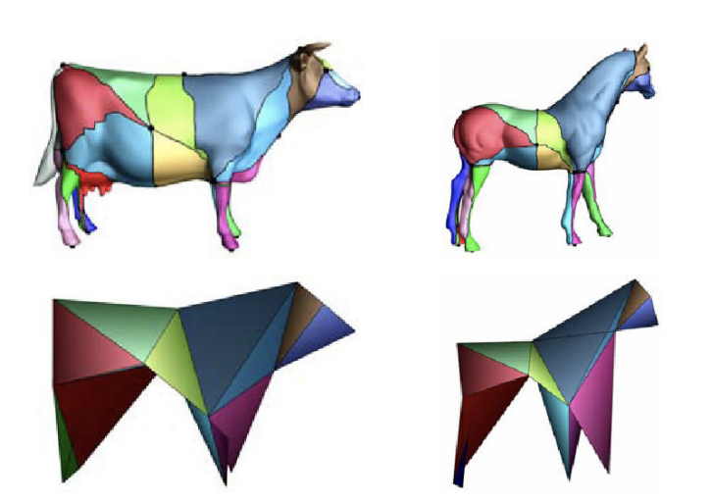
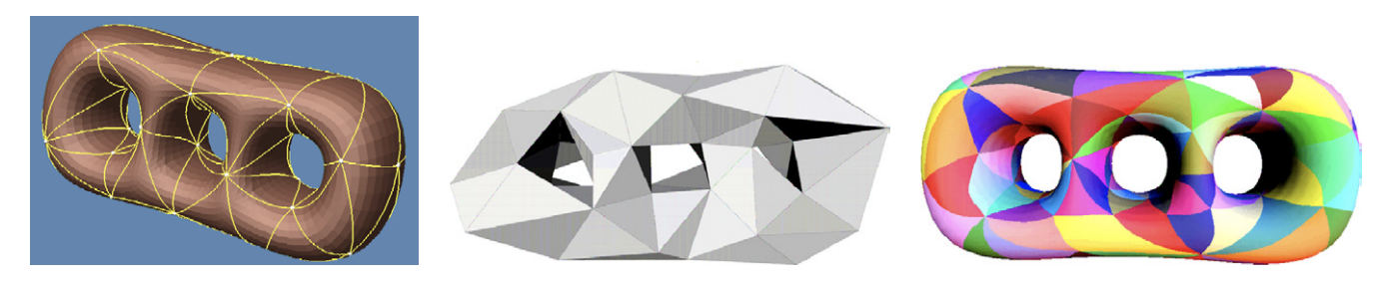
Fixed-Boundary Parameterization
<number> / 53
Fixed-boundary techniques, e.g., disk parameterization, perform poorly when 3D meshes have
  non-convex boundaries, or
  boundaries that differ significantly from the specified boundary of the planar domain.
One solution is to first segment the input mesh into triangular patches and then map them into 2D triangle boundaries.

Slide 35
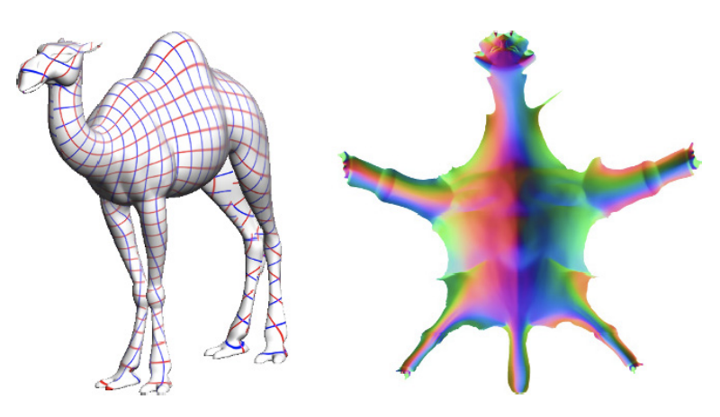
Free-Boundary Parameterization
<number> / 53
Fixed-boundary techniques, e.g., disk parameterization, perform poorly when 3D meshes have
  non-convex boundaries, or
  boundaries that differ significantly from the specified boundary of the planar domain.
Another solution is to compute the boundary of the 2D domain as part of the solution, hence free-boundary.

Slide 36
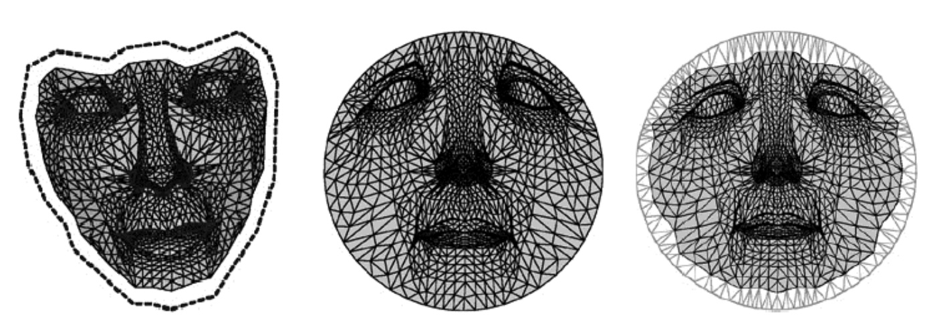
Free-Boundary Parameterization
<number> / 53
Fixed-boundary techniques, e.g., disk parameterization, perform poorly when 3D meshes have
  non-convex boundaries, or
  boundaries that differ significantly from the specified boundary of the planar domain.
Mesh Parameterization with a Virtual Boundary paper sets the boundary free as follows.
Virtual boundary (dashed) is added to the original mesh in 3D. Introduced 1+ layers of triangles around the original boundary (gray ones on the right).
Mean-value weight parameterization (method 3) here has too much distortion.
Virtual boundary mapped to a fixed convex polygon and the rest mapped via method 3. Since the original boundary vertices are free to move, less distortion achieved here.

Slide 37
Free-Boundary Parameterization
<number> / 53
All methods thus far were angle-preserving, i.e., minimize angular distortion during parameterization.
  Method 1 (uniform) was an exception as it minimizes nothing.
Multi-dimensional scaling (MDS) based method minimizes distance distortion, i.e., distance between two 3D points and their mapped 2D image points are kept as close as possible.
This one is also free-boundary as it doesn’t treat boundary differently.

Slide 38
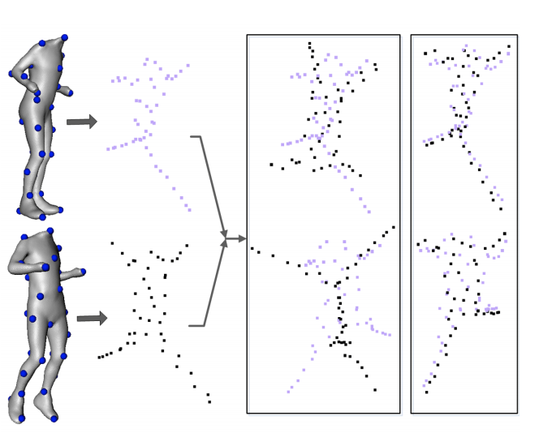
MDS-based Parameterization
<number> / 53
MDS: Embedding of the mesh into R^{k}, k=2 for planar parameterization, in such a way that pairwise dissimilarity values b/w points, e.g., geodesic distances, in R³ are replaced by the Euclidean distances in the embed space.
Here are 2 different MDS transformations from R³ to R³.
Useful for non-rigid shape correspondence problem.
  Robust 3D Shape Correspondence in the Spectral Domain
  Minimum-Distortion Isometric Shape Correspondence Using EM Algorithm.

Slide 39
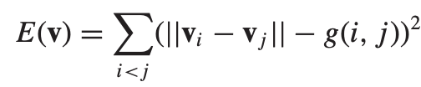
MDS-based Parameterization
<number> / 53
MDS: Embedding of the mesh into R^{k}, k=2 for planar parameterization, in such a way that pairwise dissimilarities are put in affinity matrix A.
Classical method: k leading eigenvectors of A define MDS coords in R^{k}.
Least-squares method: minimize using mass-spring system as described in Detail-Preserving Mesh Unfolding for Nonrigid Shape Retrieval.

Slide 40
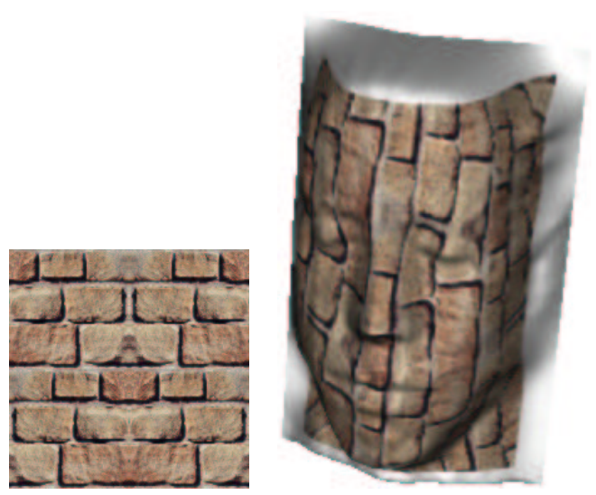
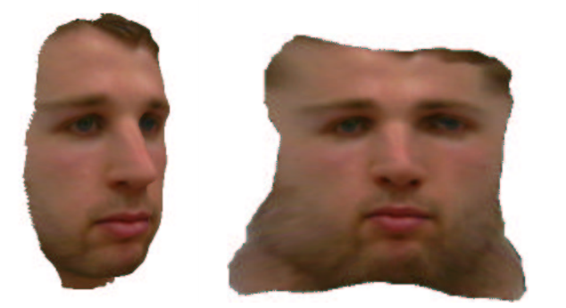
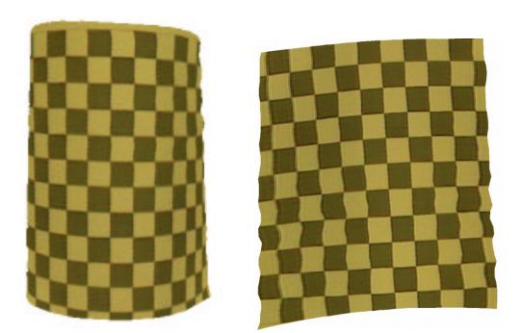
MDS-based Parameterization
<number> / 53
MDS: Embedding of the mesh into R^{k}, k=2 for planar parameterization, in such a way that pairwise dissimilarities are put in affinity matrix A.
Classical method is used in Texture Mapping Using Surface Flattening via Multidimensional Scaling to get parameterizations that are OK for non-complex surfaces such as:

Slide 41

MDS-based Parameterization
<number> / 53
MDS: Embedding of the mesh into R^{k}, k=2 for planar parameterization, in such a way that pairwise dissimilarities are put in affinity matrix A.
Classical method is accelerated and made available for large meshes via Sparse Multidimensional Scaling Using Landmark Points.
Given the embedded landmark points, this paper computes embedding coordinates for the remaining data points based on their distances from the landmark points.

Slide 42


MDS-based Parameterization
<number> / 53
MDS: Embedding of the mesh into R^{k}, k=2 for planar parameterization, in such a way that pairwise dissimilarities are put in affinity matrix A.
LMDS-like method is used in Iso-charts: Stretch-driven mesh parameterization using spectral analysis.
If the parametrizd planar mesh contains folds (local overlaps – slide17) they segment the surface and parametrize each chart independently.

Slide 43

Parameterization Refinement
<number> / 53
First, parameterize input mesh using an existing technique.
Second, apply post-processing to improve the parameterization.
  Untangling of 2D meshes in ALE simulations.
Original Texas mesh.
Tangled by random moves (not parameterization).
Untangled result.
Untangled result improved further.

Slide 44




Parameterization Refinement
<number> / 53
First, parameterize input mesh using an existing technique.
Second, apply post-processing to improve the parameterization.
  Untangling of 2D meshes in ALE simulations.
𝛼_{i}: area of the i^{th} element.
β to prevent zero-area in the minimization of f(x).
Quadratic version is differentiable/smooth for one element.
Untangle tetrahedral meshes by simply replacing areas with volumes.

Slide 45

Parameterization of Closed Meshes
<number> / 53
Closed meshes need to be cut opened before mapped to a 2D plane.
Artifacts are likely along the cuts.
Duplicate each vertex on the cut.
Change the vertex index of the triangles on one side of the cut to reference those duplicate vertices.
Now you’ve a disk topology surface that can be mapped to a 2D disk.

Slide 46

Parameterization of Closed Meshes
<number> / 53
Closed meshes need to be cut opened before mapped to a 2D plane.
Artifacts are likely along the cuts.
Duplicate each vertex on the cut.
Change the vertex index of the triangles on one side of the cut to reference those duplicate vertices.
Now you’ve a disk topology surface that can be mapped to a 2D disk.
Notes:
Image from: Spherical Orbifold Tutte Embeddings

Slide 47

Parameterization of Closed Meshes
<number> / 53
Closed meshes need to be cut opened before mapped to a 2D plane.
Artifacts are likely along the cuts.
Duplicate each vertex on the cut.
Change the vertex index of the triangles on one side of the cut to reference those duplicate vertices.
Now you’ve a disk topology surface that can be mapped to a sphere.

Slide 48

Parameterization of Closed Meshes
<number> / 53
Closed meshes need to be cut opened before mapped to a 2D plane.
Artifacts are likely along the cuts.
Duplicate each vertex on the cut.
Change the vertex index of the triangles on one side of the cut to reference those duplicate vertices.
Now you’ve a disk topology surface that can be mapped to a plane.

Slide 49

Parameterization of Closed Meshes
<number> / 53
Closed meshes need to be cut opened before mapped to a 2D plane.
A basic method for cut/seam computation is based on Minimum Spanning Tree computation on high-curvature parts.
  From the base to the cat’s head, adding nodes on the ear tips as the extreme curvature points.
  Spanning Tree Seams for Reducing Parameterization Distortion of Triangulated Surfaces.

Slide 50
Parameterization of Closed Meshes
<number> / 53
Closed meshes need to be cut opened before mapped to a 2D plane.
A basic method for cut/seam computation is based on Minimum Spanning Tree computation on high-curvature parts.
  Blue is a connected cut w/o loops (tree), which turns a closed surf into one disk topology surface that can be mapped to a single disk.

Slide 51

Parameterization of Closed Meshes
<number> / 53
Closed meshes need to be cut opened before mapped to a 2D plane.
Another kind of surface cutting algorithm segments the surface to many parts, each disk topology, that can be independently mapped charts.
More common because it is really hard to get a single connected cut that will map the surface to a single chart without large distortion.

Slide 52

Parameterization of Closed Meshes
<number> / 53
Closed meshes need to be cut opened before mapped to a 2D plane.
Better methods that optimize for seam computation and parameterization jointly.
  OptCuts: Joint Optimization of Surface Cuts and Parameterization
  Autocuts: Simultaneous Distortion and Cut Optimization for UV Mapping

Slide 53


Parameterization of Closed Meshes
<number> / 53
Closed meshes need to be cut opened before mapped to a 2D plane.
  See https://youtu.be/Yi8i5iKVO7s & https://youtu.be/_W2ipCpCz8g for cool demonstrations.

